Slide 1

Knative Serverless to architect atomically decomposed components
Maarten Vandeperre
Specialist Solution Architect
Red Hat
Bart Joris
Account Solution Architect
Red Hat

Slide 2

Knative overview

Slide 3

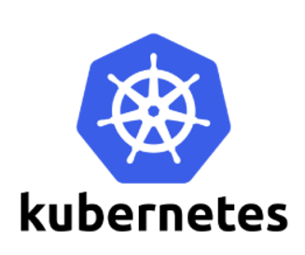

A simple application on Kubernetes
apiVersion: apps/v1
kind: Deployment
metadata:
name: basic-app
spec:
selector:
matchLabels:
app: basic-app
template:
metadata:
labels:
app: basic-app
spec:
containers:
- name: basic-app
image: <your-basic-app-image>
ports:
- containerPort: 8080
---
apiVersion: v1
kind: Service
metadata:
name: basic-app-service
spec:
selector:
app: basic-app
ports:
- protocol: TCP
port: 80
targetPort: 8080
---
apiVersion: autoscaling/v2beta2
kind: HorizontalPodAutoscaler
metadata:
name: basic-app-autoscaler
spec:
scaleTargetRef:
apiVersion: apps/v1
kind: Deployment
name: basic-app
minReplicas: 1
maxReplicas: 10
metrics:
- type: Resource
resource:
name: cpu
targetAverageUtilization: 50

Slide 4

A/B testing a simple application
Need to:
Create k8s deployments
Create k8s services
Create proxy
Configure proxy
(Configure k8s ingress)
apiVersion: apps/v1
kind: Deployment
metadata:
name: basic-app
spec:
replicas: 1
selector:
matchLabels:
app: basic-app
template:
metadata:
labels:
app: basic-app
spec:
containers:
- name: basic-app
image: <your-basic-app-image>
ports:
- containerPort: 8080
---
apiVersion: v1
kind: Service
metadata:
name: basic-app-service
spec:
selector:
app: basic-app
ports:
- protocol: TCP
port: 80
targetPort: 8080
---
apiVersion: autoscaling/v2beta2
kind: HorizontalPodAutoscaler
metadata:
name: basic-app-autoscaler
spec:
scaleTargetRef:
apiVersion: apps/v1
kind: Deployment
name: basic-app
minReplicas: 1
maxReplicas: 10
metrics:
- type: Resource
resource:
name: cpu
targetAverageUtilization: 50
---
apiVersion: apps/v1
kind: Deployment
metadata:
name: newer-app
spec:
replicas: 1
selector:
matchLabels:
app: newer-app
template:
metadata:
labels:
app: newer-app
spec:
containers:
- name: newer-app
image: <your-newer-app-image>
ports:
- containerPort: 8080
---
apiVersion: autoscaling/v2beta2
kind: HorizontalPodAutoscaler
metadata:
name: newer-app-autoscaler
spec:
scaleTargetRef:
apiVersion: apps/v1
kind: Deployment
name: newer-app
minReplicas: 1
maxReplicas: 10
metrics:
- type: Resource
resource:
name: cpu
targetAverageUtilization: 50
---
apiVersion: v1
kind: Service
metadata:
name: newer-app-service
spec:
selector:
app: newer-app
ports:
- protocol: TCP
port: 80
targetPort: 8080
---
apiVersion: apps/v1
kind: Deployment
metadata:
name: haproxy
spec:
replicas: 1
selector:
matchLabels:
app: haproxy
template:
metadata:
labels:
app: haproxy
spec:
containers:
- name: haproxy
image: <your-haproxy-image>
ports:
- containerPort: 80
- containerPort: 443
global
log /dev/log local0
log /dev/log local1 notice
chroot /var/lib/haproxy
stats socket /run/haproxy/admin.sock mode 660 level admin
stats timeout 30s
user haproxy
group haproxy
daemon
defaults
log global
mode http
option httplog
option dontlognull
timeout connect 5000
timeout client 50000
timeout server 50000
frontend http-in
bind *:80
acl is_90_percent random(0, 99) lt 90
use_backend backend1 if is_90_percent
default_backend backend2
backend backend1
server backend1 <backend1-ip>:<backend1-port>
backend backend2
server backend2 <backend2-ip>:<backend2-port>

Slide 5

Serverless computing - What’s in a name?
Simplify deployment of applications
Don’t worry about underlying infrastructure (including kubernetes)
Only use resources when needed
There are always servers running somewhere !
Picture from: https://pixabay.com/illustrations/rage-angry-frustrated-emotion-1015611/

Slide 6
What is Knative?
Knative is a Kubernetes Native implementation of Serverless technology
CNCF incubating project
From the Open Source project site - “Knative is an Open-Source Enterprise-level solution to build Serverless and Event Driven Applications”
Knative provides a set of additional Objects (through CRD’s) that allow the management of Serverless components.
More yaml? => kn CLI

Slide 7
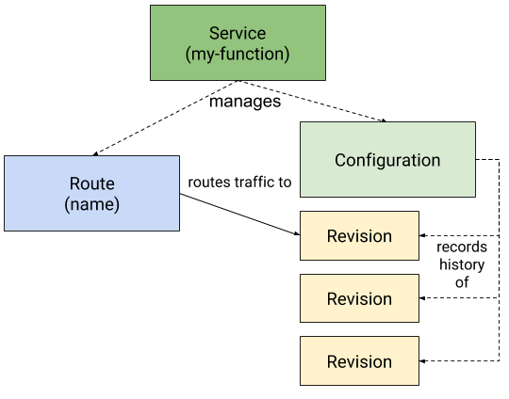
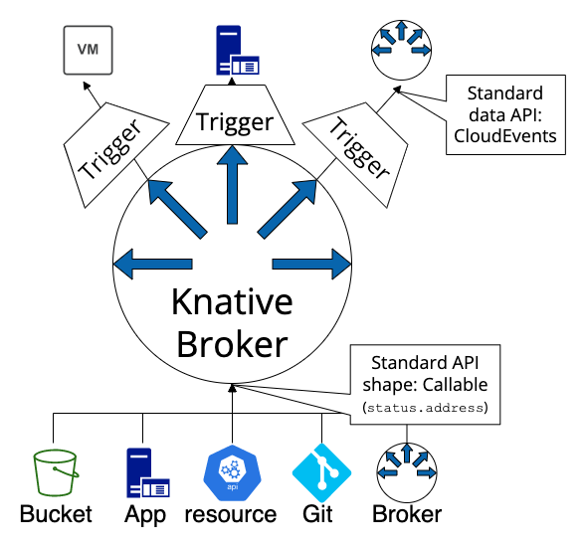
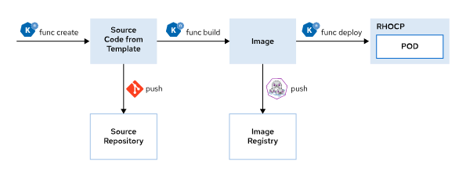

Knative overview
Serving
Eventing
Functions
Builds

Slide 8
Knative Serving

Slide 9
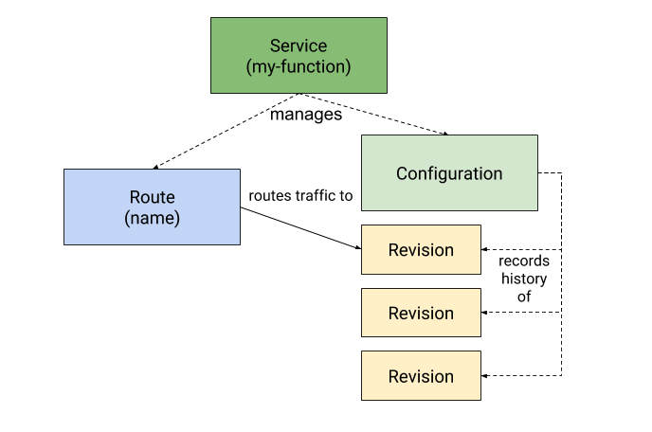
Knative Serving Basics
Knative Serving is realised using four CRD components:
Services - controller object that orchestrates the other components
Configurations - defines the state of the deployment. Editing the configuration generates a new Revision
Revision - immutable point-in-time snapshot of configuration
Routes - maps a network endpoint to one or more Revisions
Picture from https://knative.dev/docs/concepts/#what-is-knative

Slide 10
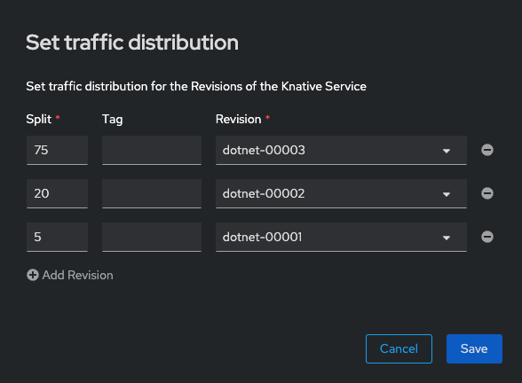
Revisions
A new Revision is created when the configuration of a knative Serving Application is changed
Revisions are immutable
Routes allow for changing the distribution of traffic arriving to push traffic to multiple Revisions
Allows for Blue/Green deployments, A/B testing, canary release
Revisions can have their own entry point
Notes:
Change config (new image, env variables) => new revision
Using tags, directly connect to a service
No need to set up a new environment to test something

Slide 11
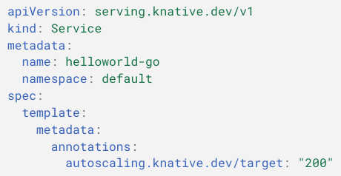
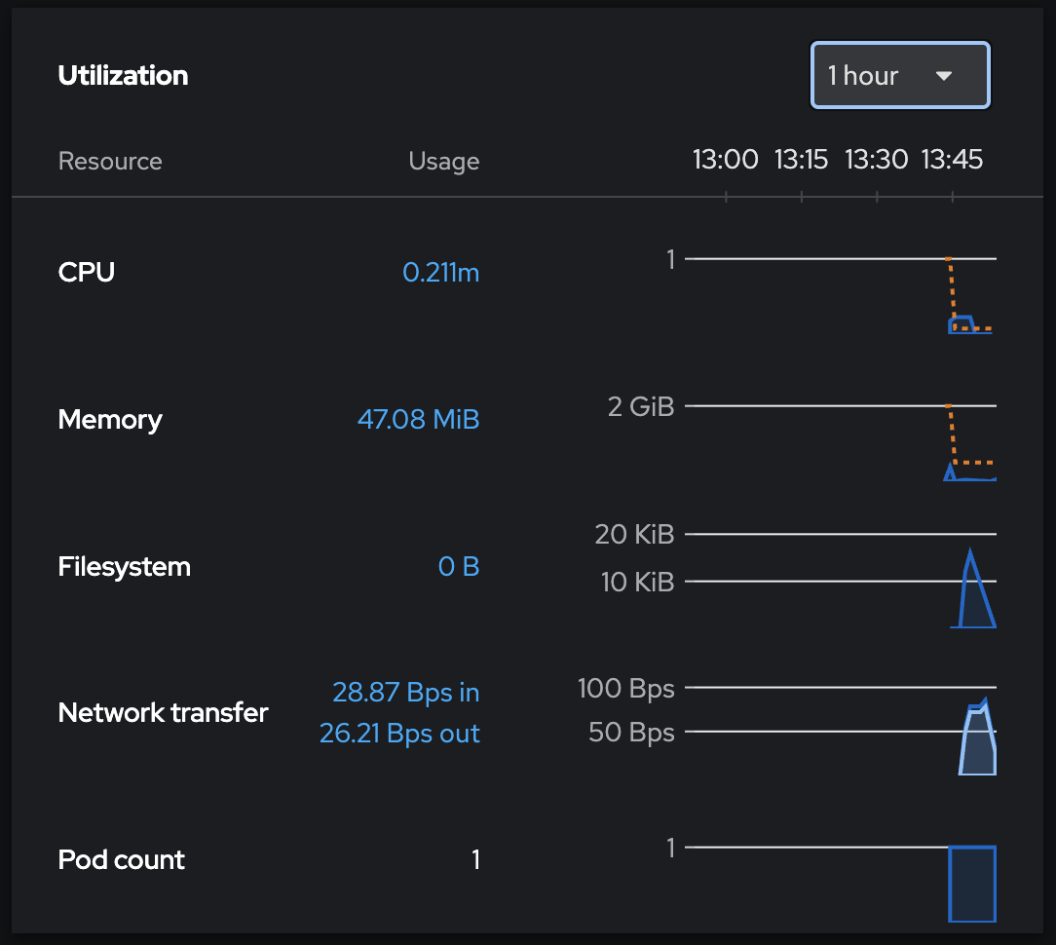
Knative Serving Autoscaling
Knative Serving provides auto-scaling to match incoming demand
Scaling based on HTTP requests!
Scale-to-zero (can be disabled)
=> More efficient resource consumption
Configure scaling:
concurrency (how many requests can be simultaneously processed by each replica) , or
requests-per-second (per replica)
configured per Revision (annotations) or globally (config-map or operator)
Notes:
Limitation = HTTP

Slide 12
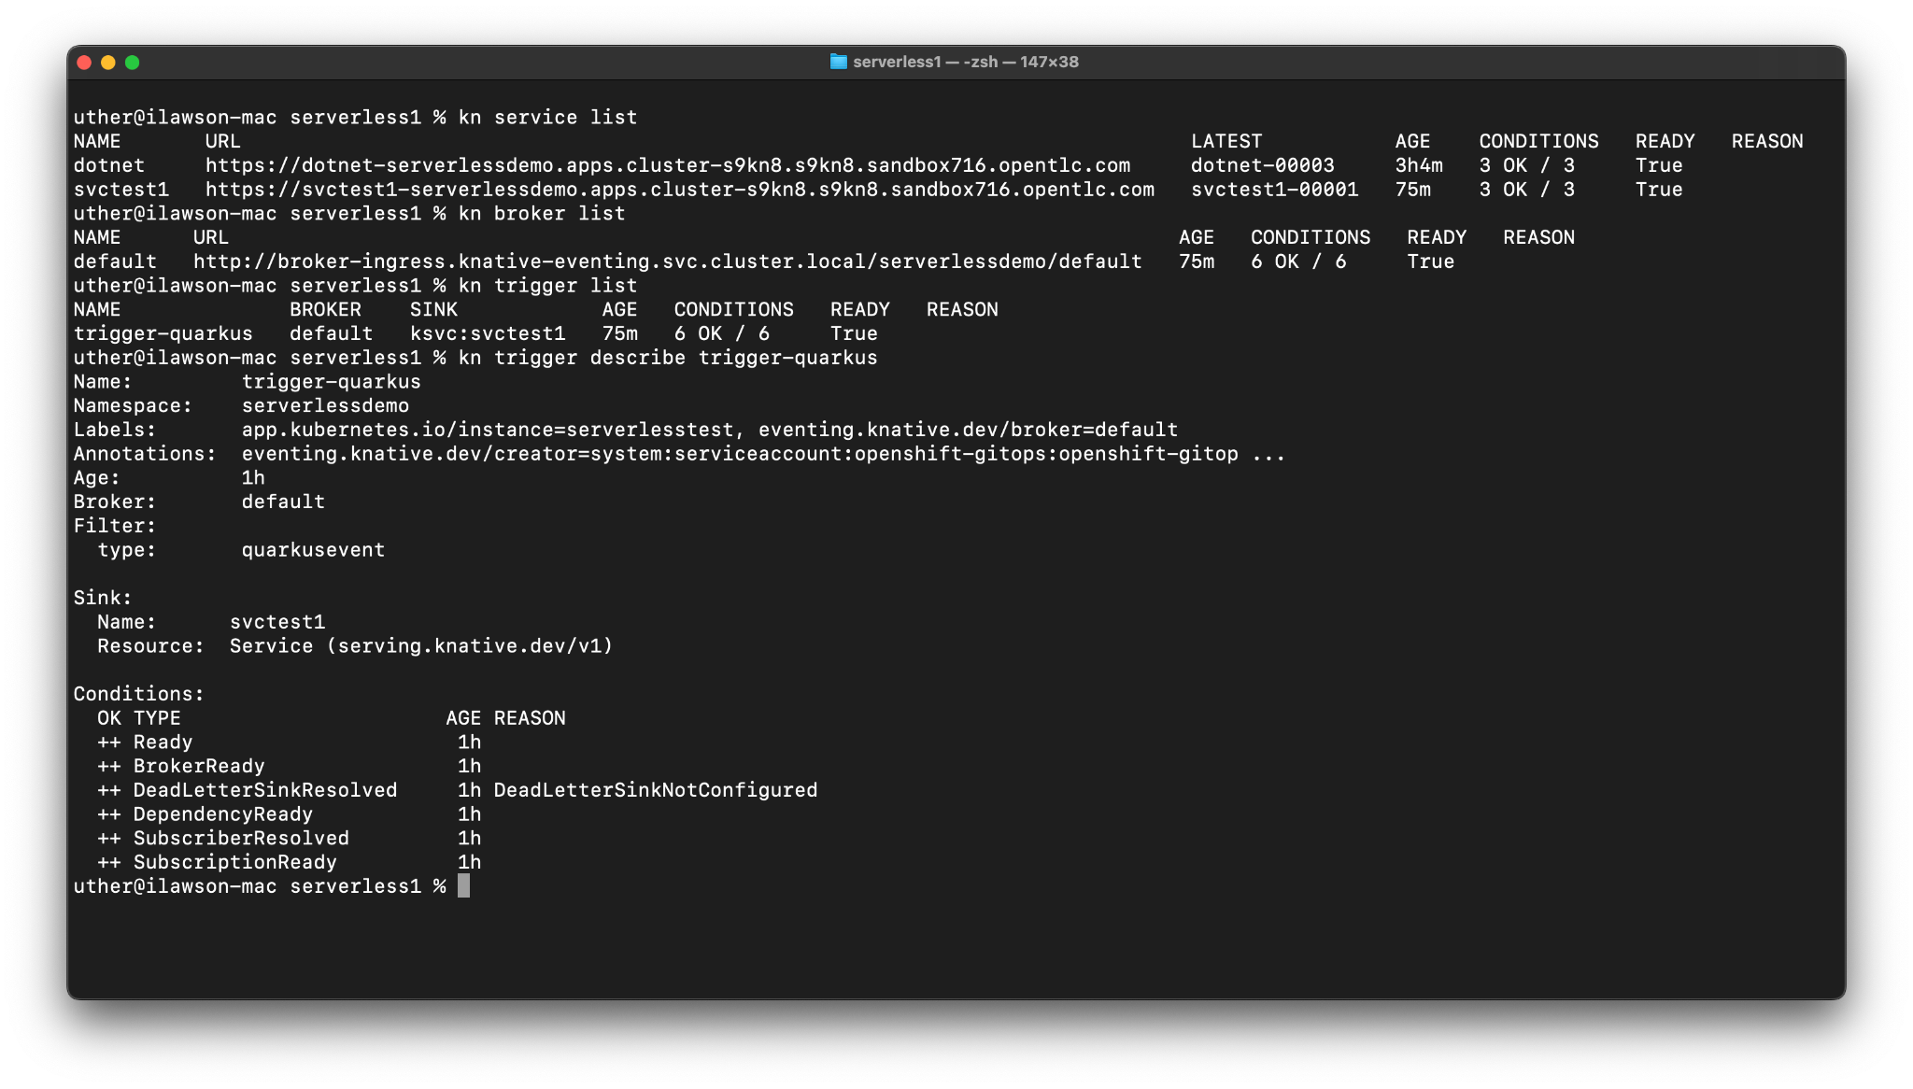
Direct Control of Knative objects
Knative also provides a command-line utility called kn
kn allows you to create, modify and delete all knative objects directly on a target Kubernetes/OpenShift cluster

Slide 13
Knative Serving
kn service create myservice --image docker.io/openshift/hello-openshift --env RESPONSE="hello1"
kn service update myservice --env RESPONSE="hello2"
kn service update myservice --traffic myservice-00001=50,myservice-00002=50

Slide 14
Knative Eventing

Slide 15
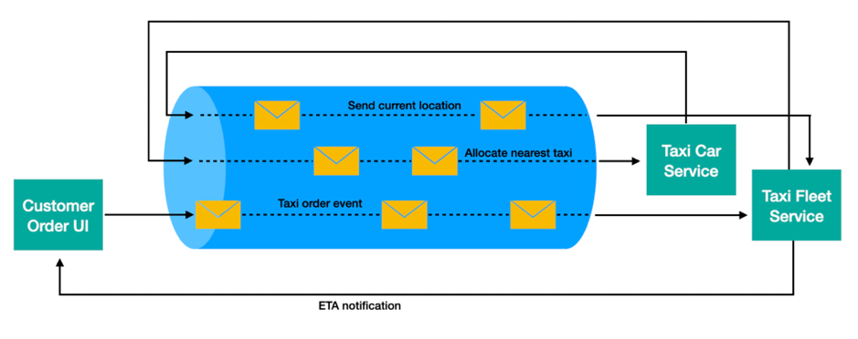
Event-driven architecture
Microservices that exchange info through events
Asynchronous (contrast to REST architectures)
Loosely coupled
Resilient
Scalable
Picture from: https://developer.ibm.com/articles/advantages-of-an-event-driven-architecture/
Notes:
Asynchronous
Contrast with REST
You do a call, wait for the result
Wait long if service takes a long time
If the result is a failure (service is down), you will have to try again (EDA, you can replay)
If you have many consumers (services), you do more calls
Not with EDA
Create event, stop caring
Loosely coupled
Producers do not need to concern themselves with how the events they produce are going to be consumed
Consumers do not need to concern themselves with how they were produced.
Microservices can be in different languages
You can add consumers/producers without needing to change any logic
Resilient
Queued
Handle delivery failure (deadLetterSink)
CloudEvents
ID is a unique identifier for the event
Source is a textual representation of the Producer
Type is effectively the target for the CloudEvent
Data is the payload
The combination of ID and Source provides the unique ‘consumed’ reference for Eventing

Slide 16

CloudEvents
CNCF incubating project - https://cloudevents.io/
Provides a common event schema
=> Interoperability, portability
Extensible through extension attributes
SDKs for different programming languages
Protocol-agnostic (HTTP, AMQP, MQTT, …)
Wide adoption
Notes:
Default attributes, optional attributes, extensions,
Protocol agnostic => HTTP
CloudEvents
ID is a unique identifier for the event
Source is a textual representation of the Producer
Type is effectively the target for the CloudEvent
Data is the payload
The combination of ID and Source provides the unique ‘consumed’ reference for Eventing

Slide 17
Knative Eventing
Eventing is a set of APIs for routing events from Producers to Consumers (known as Sinks)
CloudEvent specification
allows for the creation of Serverless components that are driven by Event rather than Traffic

Slide 18
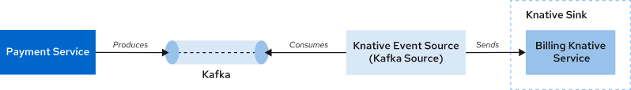
Knative Source
Knative Source:
PingSource
APIServerSource
KafkaSource
SinkBinding
…
kn source ping create <pingsource-name> \
--namespace <namespace> \
--schedule "<cron-schedule>" \
--data '<data>' \
--sink <sink-name>
Notes:
Easiest model = source to sink
Source = generates events
Sink = listens to them (another service, or something more advanced as a broker)
A source could be your own service that directly sends to the sink through a URL
Some other sources exist
Ping
API
Kafkasource
To integrate an existing kafka, with knative service
SinkBinding
Kubernetes resources (e.g. Deployment), or Knative abstractions (e.g. Service, Configuration)
provides a framework for injecting K_SINK (destination address) and K_CE_OVERRIDES (JSON cloudevents attributes) environment variables into any Kubernetes resource

Slide 19
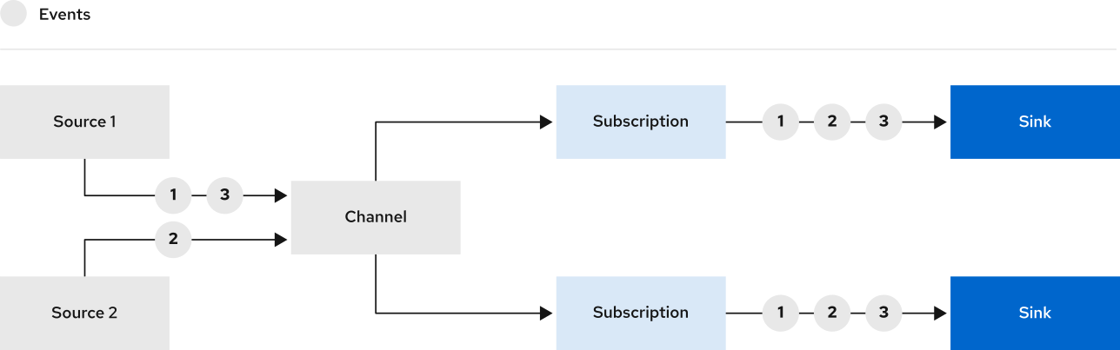
Channels and Subscriptions
provides a delivery mechanism for Cloudevents, through Subscriptions, to multiple destinations or Sinks
Sinks are consumers of events and can include Brokers and Knative Services
Subscriptions are used to hook together the Channel and the Sink
Notes:
Only need part of the events? Dedicated channel, or filter yourself

Slide 20
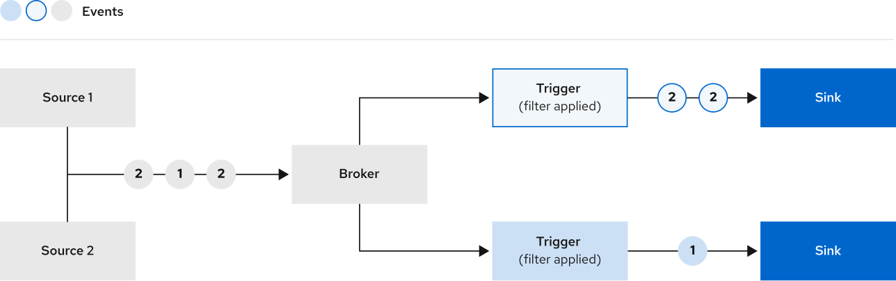
Brokers and Triggers
Brokers are namespace bound Cloudevent receivers/forwarders
Triggers are forwarders that push events to Consumers
Triggers use the cloudevent metadata (attributes) to filter cloudevents
Notes:
More flexible than channels, because Sinks could partially receive the same events.
Example:
Type A, B, C

Slide 21
Knative Eventing
kn broker create <broker-name>
kn trigger create <name> --sink <sink> --broker <broker-name> --filter <attribute>=<value>
kn source binding <name> --subject "Service:serving.knative.dev/v1:<service-name>" --sink broker:<broker-name>
Notes:
<sink>
broker, channel, Knative service or URI.
The SinkBinding object injects environment variables into the PodTemplateSpec of the sink.
K_SINK - The URL of the resolved sink.
K_CE_OVERRIDES - A JSON object that specifies overrides to the outbound event.

Slide 22
Ephemeral or Persistent
Channel options (*):
InMemoryChannel
KafkaChannel
NatssChannel
Broker options (*):
Channel based broker
default
backed by InMemoryChannel
ephemeral
Knative Broker for Apache Kafka
RabbitMQ broker
* Brokers/channels lists on https://knative.dev/docs/eventing/
apiVersion: eventing.knative.dev/v1
kind: Broker
metadata:
annotations:
# case-sensitive
eventing.knative.dev/broker.class: Kafka
# Optional annotation to point to an externally managed kafka topic:
# kafka.eventing.knative.dev/external.topic: <topic-name>
name: default
namespace: default
spec:
# Configuration specific to this broker.
config:
apiVersion: v1
kind: ConfigMap
name: kafka-broker-config
namespace: knative-eventing
Notes:
Ephemeral:
No resilience ?

Slide 23
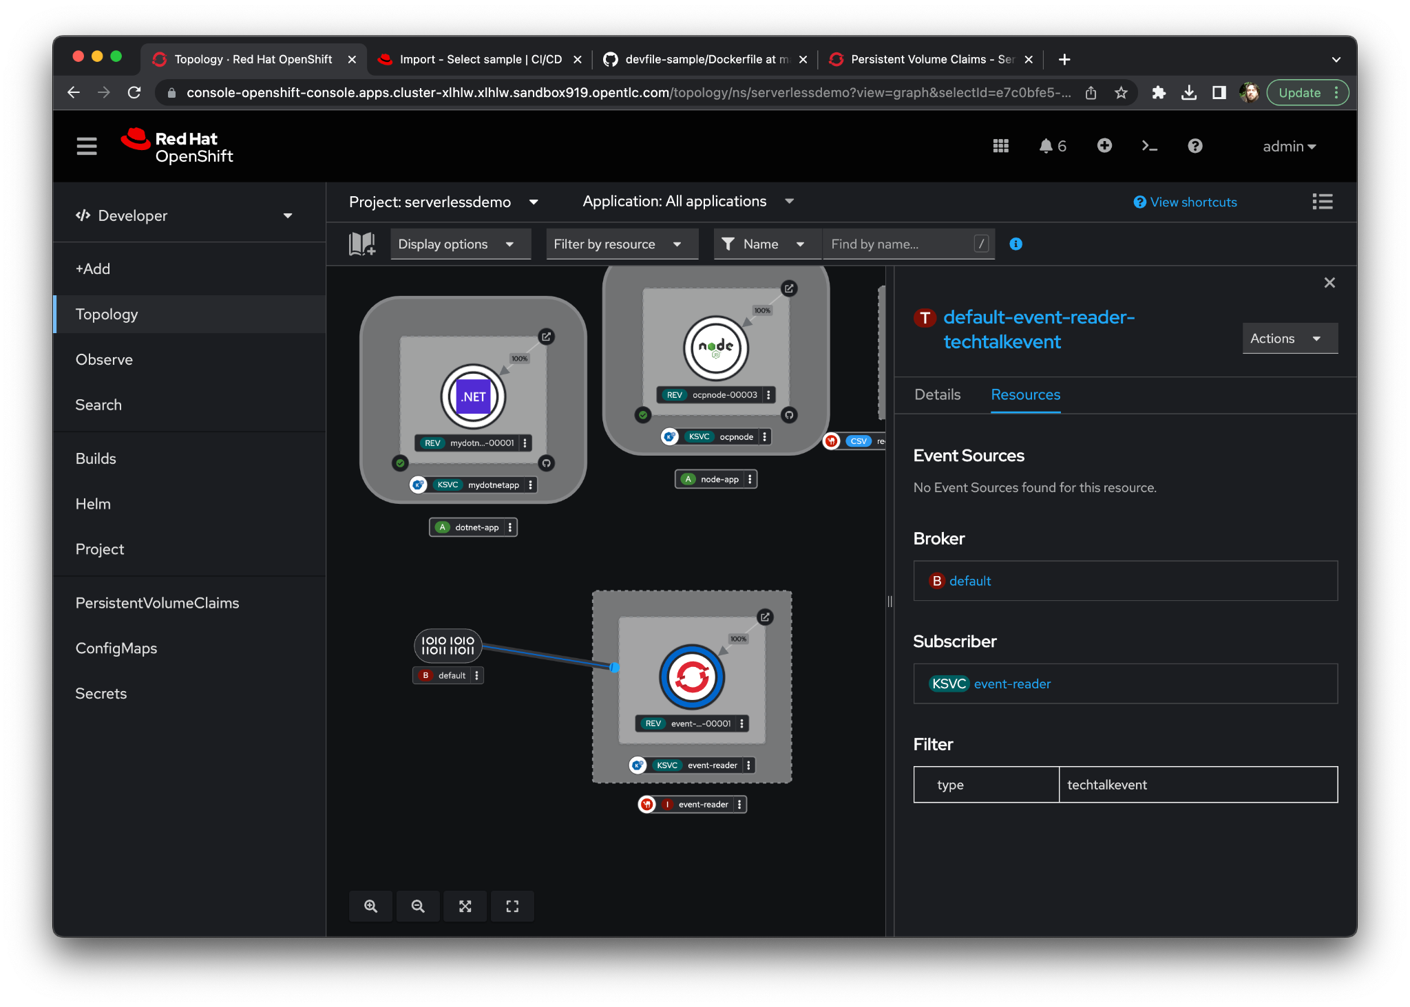
Knative Eventing vs Serving
Serving allows us to create services that can scale dynamically
Eventing allows for the creation of Event-driven architectures
Knative Serving applications can act as sinks for Eventing
=> a combination of EDA and efficient resource Applications

Slide 24
Use Case

Slide 25
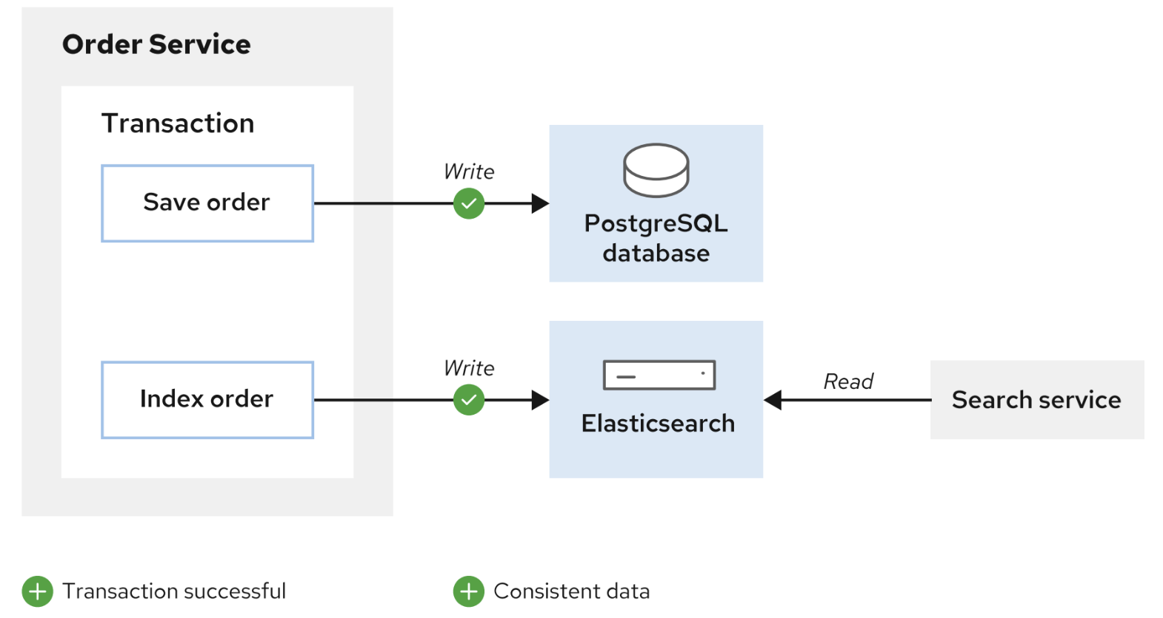
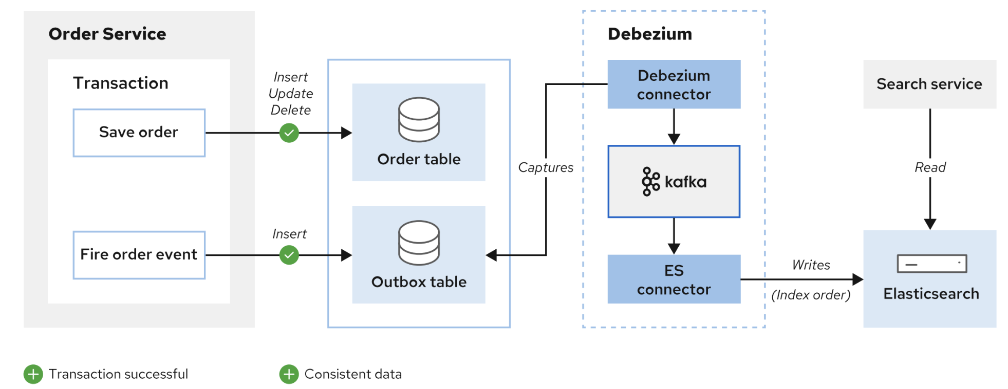

Slide 26
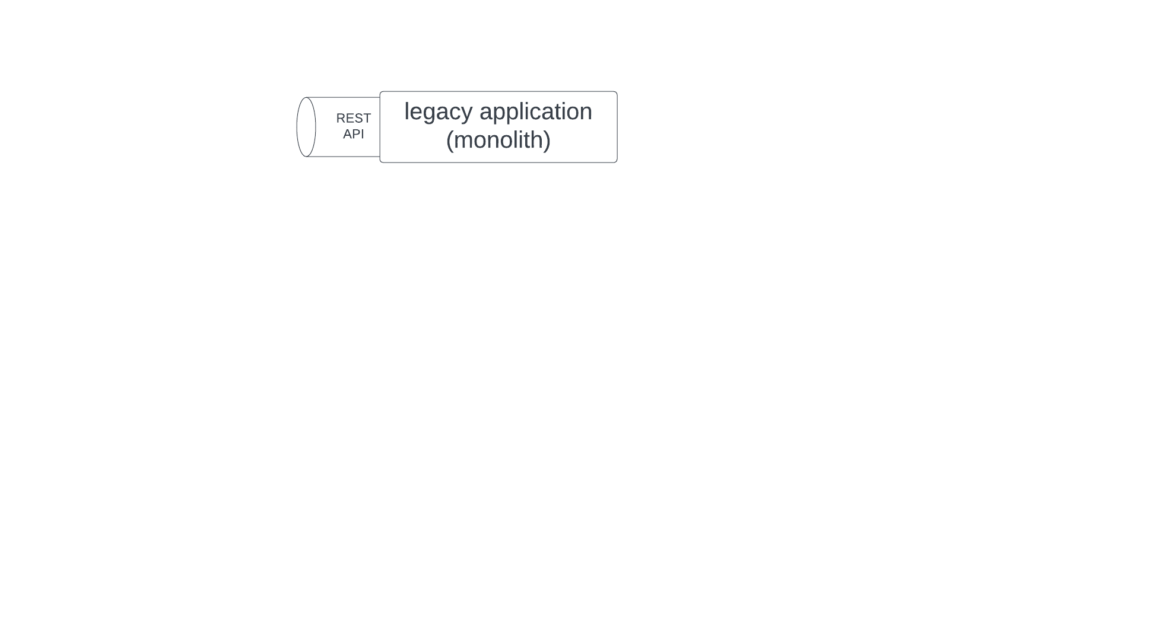

Slide 27
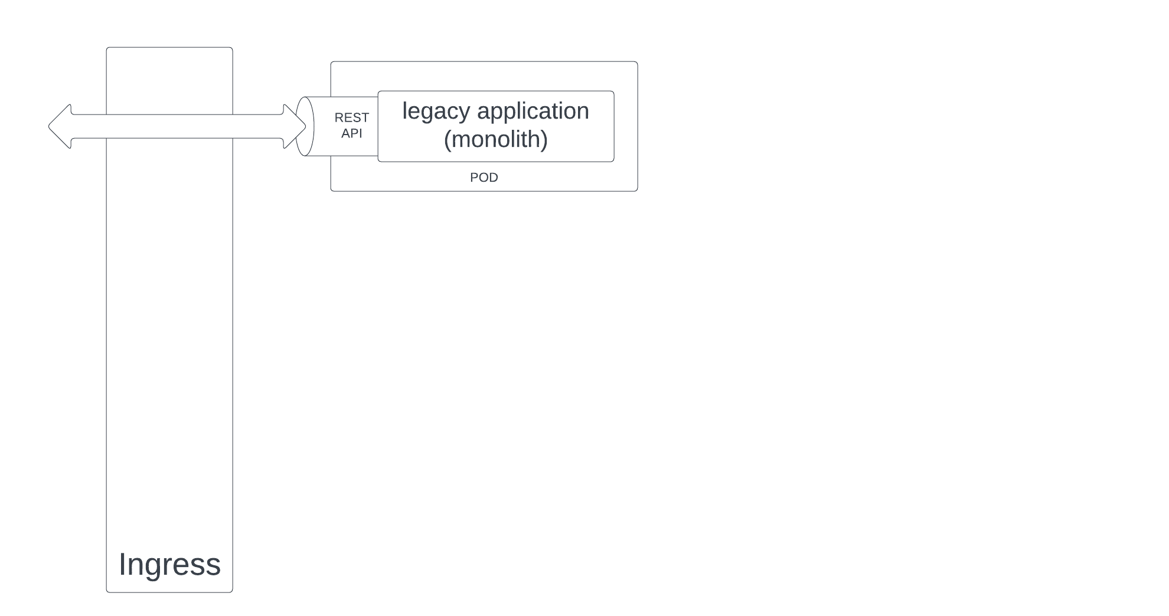

Slide 28
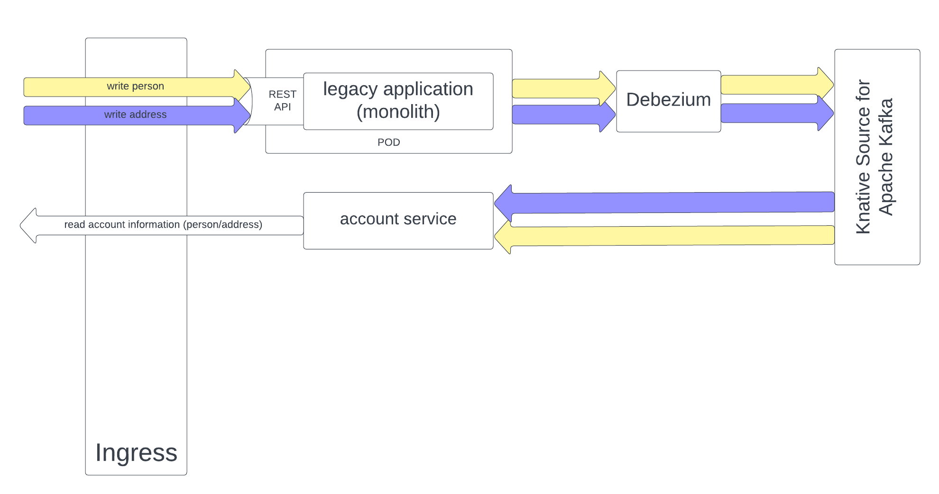

Slide 29
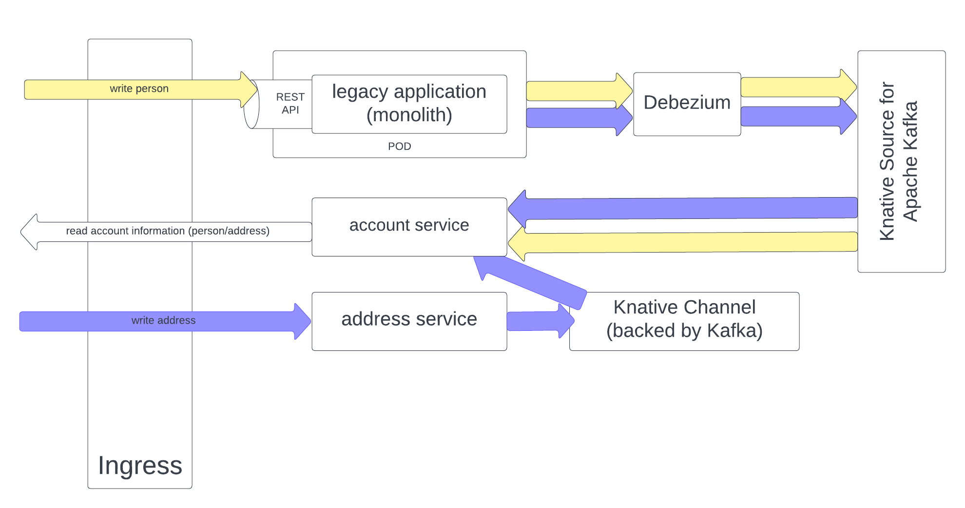

Slide 30
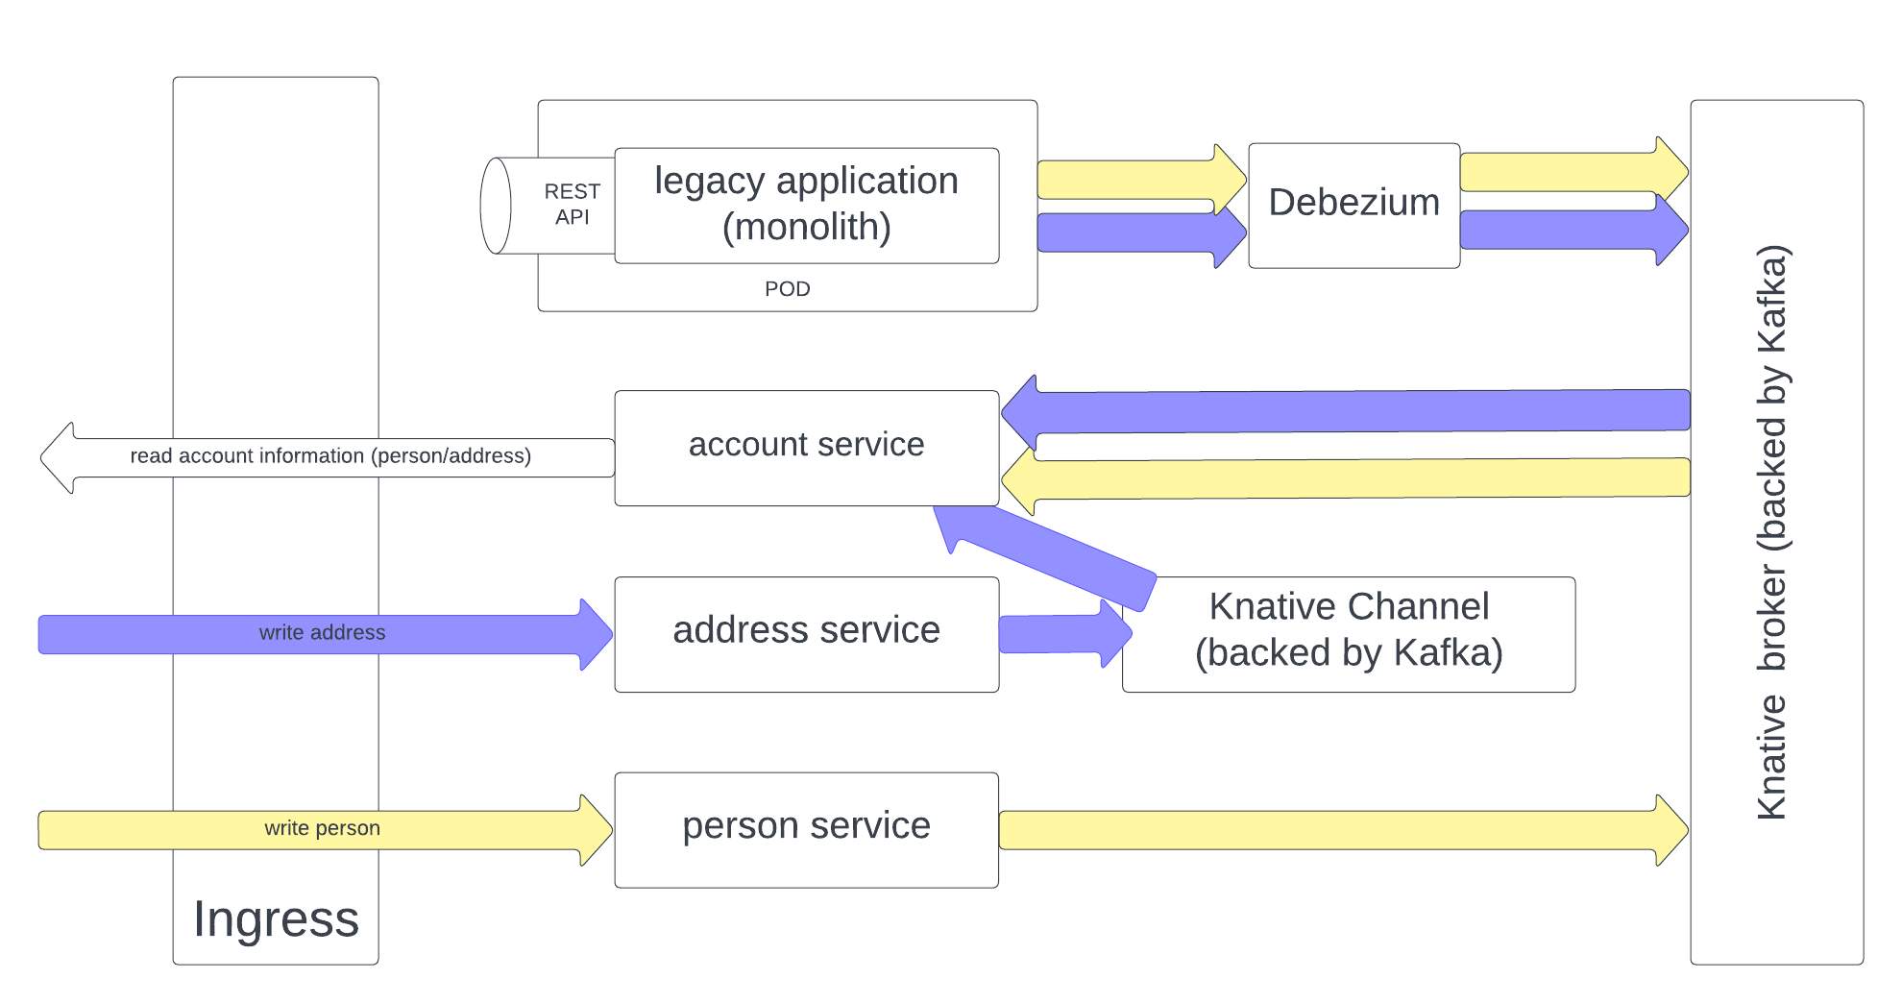

Slide 31
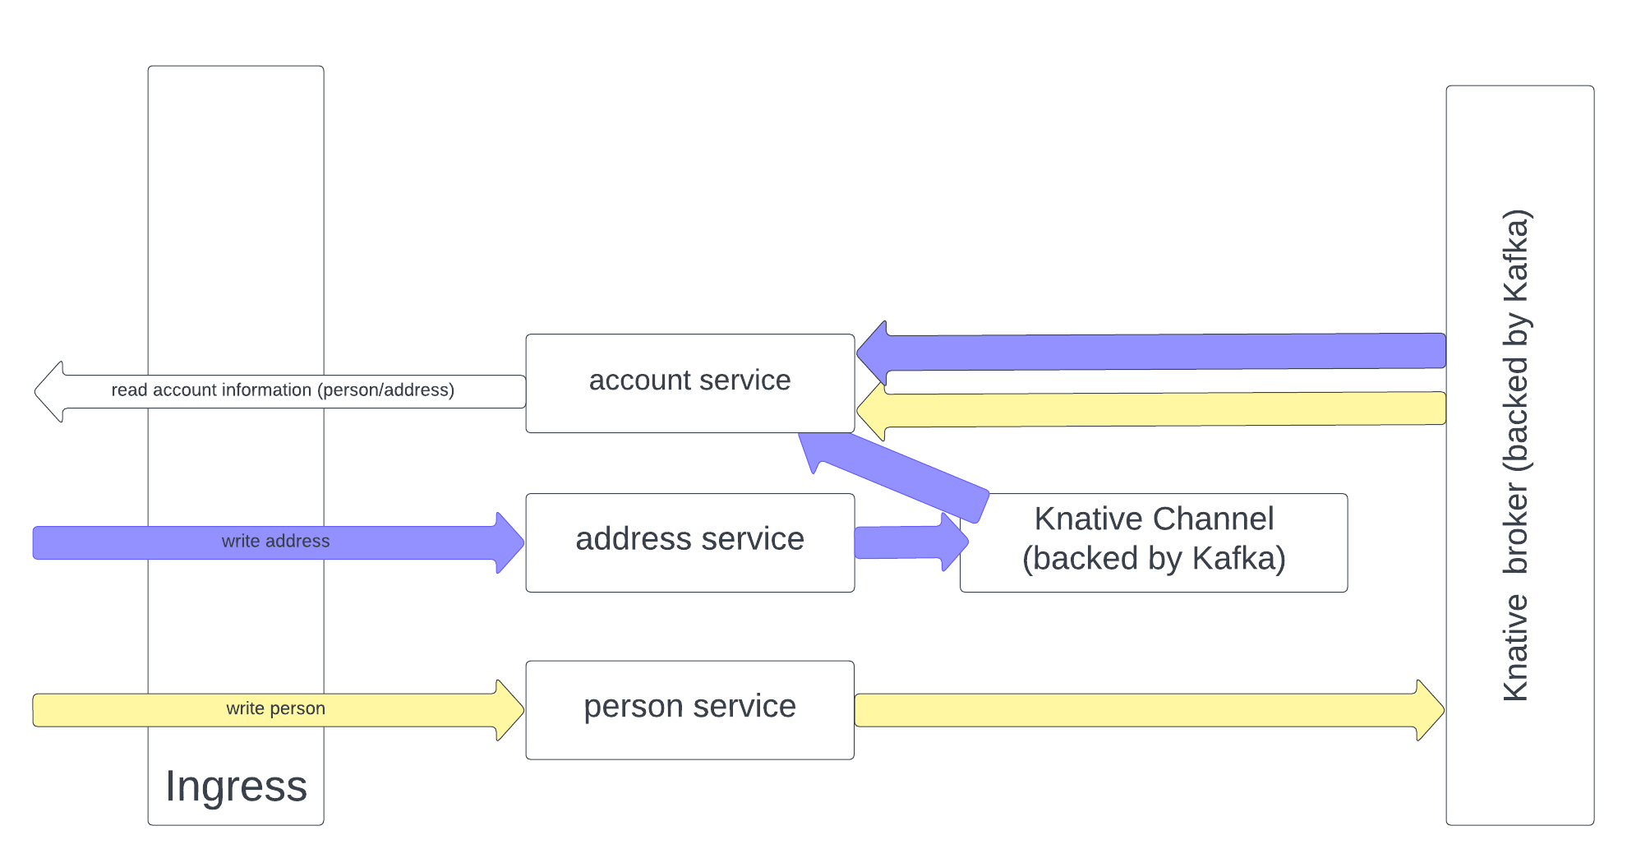

Slide 32


Demo Time

Slide 33

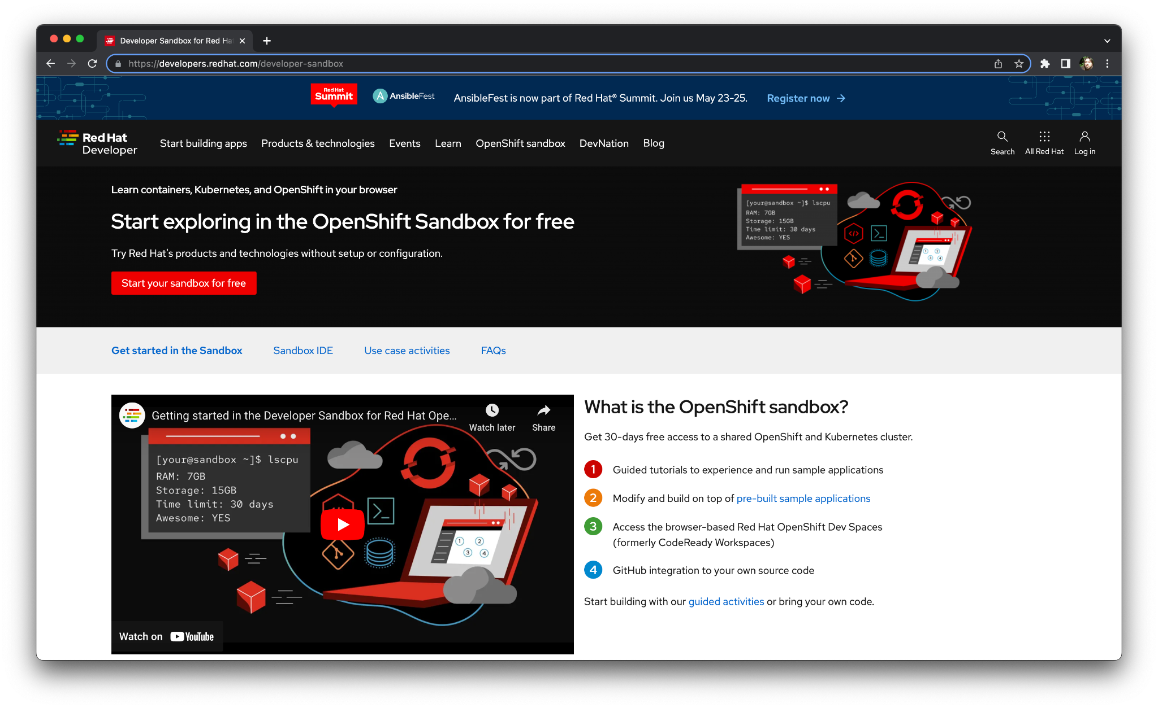
Want a quick tinker?
Red Hat provides a free-to-use OpenShift experience at:
https://developers.redhat.com/developer-sandbox

Slide 34
Thank you!

